Slide 1
UNIVERSITY COLLEGE OF ENGINEERING,NAGERCOIL
(A constituent collage of Anna University, Chennai)
Presented by: Brithiksha NV
Register no : 962821104704
NM ID : aut9628cse3001
Department : Computer Science and Engineering

Slide 2
PROJECT TITLE:
FRUIT AND VEGETABLE CLASSIFICATION USING CNN

Slide 3


AGENDA
PROBLEM STATEMENT
PROJECT OVERVIEW
WHO ARE THE END USERS?
YOUR SOLUTION AND ITS VALUE PROPOSITION
THE WOW IN YOUR SOLUTIONS
MODELLING
RESULTS
3/21/2024 Annual Review

Slide 4

PROBLEM STATEMENT
Develop a Convolutional Neural Network (CNN) model for fruit and vegetable classification.
Use a labeled dataset containing diverse images for training and validation.
Aim for high accuracy in discerning between different types of produce.
Enable applications in automated sorting systems and food recognition technology.
Create an efficient solution for fruit and vegetable classification.
Contribute to advancements in agriculture, food processing, and retail industries.

Slide 5
Evaluation of model performance using metrics like accuracy and F1-score.
Aims to enhance efficiency and accuracy in fruit and vegetable sorting tasks.
Benefits stakeholders in agriculture and food industries through automation and improved processes.

Slide 6

PROJECT OVERVIEW
Project aims to develop a computer vision system using CNNs for accurate fruit and vegetable classification.
Utilizes deep learning techniques and image processing for automated sorting and classification.
Targets industries like agriculture and food processing for improved efficiency.
System processes images of fruits and vegetables, employing advanced deep learning methods.
Key objectives include dataset preprocessing, augmentation, and CNN architecture design.
Focuses on extracting discriminative features and classifying produce into distinct categories.

Slide 7

WHO ARE THE END USERS?
1.Farm owners and workers responsible for sorting and categorizing harvested fruits and vegetables.
2. Food packaging and processing companies incorporating automated sorting systems for quality control and efficient production.
3. Supermarket chains and grocery store managers seeking improved inventory management and product categorization.
4. Restaurants and catering services requiring efficient sourcing and identification of fresh produce for menu preparation.
5. Food delivery services relying on accurate classification of fruits and vegetables for order fulfillment and customer satisfaction.

Slide 8

YOUR SOLUTION AND ITS VALUE PROPOSITION
Solution Overview:
Development and deployment of a Convolutional Neural Network (CNN) model.
Trained on a diverse dataset of labeled images of fruits and vegetables.
Utilizes deep learning and image processing algorithms.
Enables accurate classification of produce based on image data.
Offers automated sorting and categorization capabilities.

Slide 9
Value Proposition:
High accuracy in fruit and vegetable classification.
Reduced manual sorting efforts and minimized errors.
Enhanced efficiency in agriculture, food processing, and retail.
Quality control by identifying damaged or defective produce.
Scalable solution adaptable to various operational scales.
Empowers stakeholders with real-time data for informed decision-making.

Slide 10

THE WOW IN YOUR SOLUTION
Cutting-edge CNN model utilizes state-of-the-art deep learning techniques.
Achieves remarkable accuracy in classifying a wide variety of fruits and vegetables.
Offers seamless automation, drastically reducing manual labor and time.
Enhances operational efficiency and productivity across multiple industries.
Enables real-time decision-making with actionable insights from accurate data.
Empowers businesses to deliver higher-quality products and services to consumers.
Represents a significant leap forward in the evolution of automated sorting and classification technologies.

Slide 11
MODELLING
Data Collection:
Gather a diverse dataset of labeled images containing various types of fruits and vegetables.
Ensure sufficient representation of different classes to avoid bias and improve model generalization.
2. Data Preprocessing:
Resize all images to a uniform size suitable for input to the CNN model.
Normalize pixel values to a common scale (e.g., [0, 1]) for improved convergence during training.
Augment the dataset with techniques such as rotation, flipping, and cropping to increase diversity and robustness.

Slide 12
3. Model Architecture Design:
Design a CNN architecture comprising convolutional, pooling, and dense layers.
Experiment with different architectures, adjusting the number of layers, filter sizes, and activation functions.
Consider the use of pre-trained models (e.g., VGG, ResNet) for transfer learning to leverage existing feature representations.
4. Model Training:
Split the dataset into training, validation, and testing sets to evaluate model performance.
Train the CNN model using the training data, optimizing for accuracy and loss metrics.
Utilize techniques such as early stopping and learning rate scheduling to prevent overfitting and improve convergence.
5. Model Evaluation:
Evaluate the trained model on the validation and testing sets to assess performance metrics.
Use confusion matrices and ROC curves to visualize model performance and identify areas for improvement.

Slide 13
6. Model Optimization:
Fine-tune hyperparameters such as learning rate, batch size, and optimizer choice to optimize model performance.
Experiment with regularization techniques (e.g., dropout, L2 regularization) to prevent overfitting.
Consider ensemble methods or model stacking to improve classification accuracy further.
7. Deployment and Integration:
Deploy the trained model as a service or integrate it into existing applications or systems.
Provide APIs or user interfaces for easy access and interaction with the model.
Ensure scalability and reliability of the deployed solution to handle varying workloads and demands.
8. Monitoring and Maintenance:
Implement monitoring tools to track model performance and detect drift or degradation over time.
Regularly retrain the model using new data to adapt to changing trends and patterns.
Continuously update and improve the model based on user feedback and evolving requirements.

Slide 14
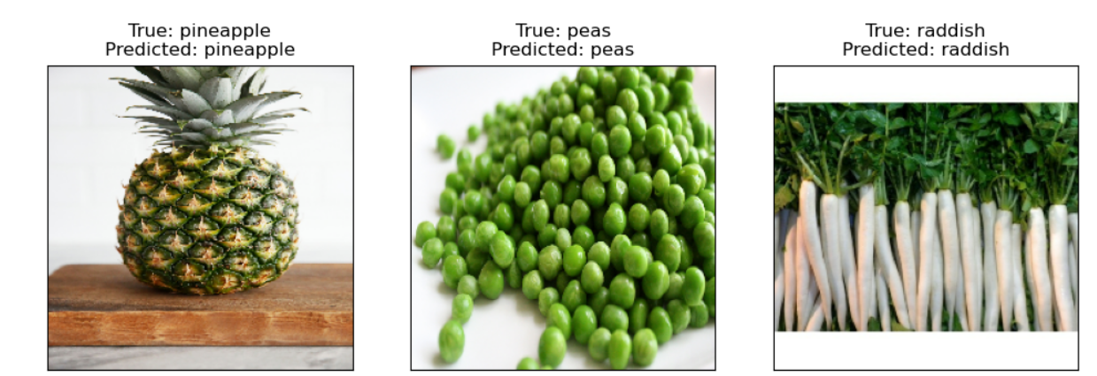
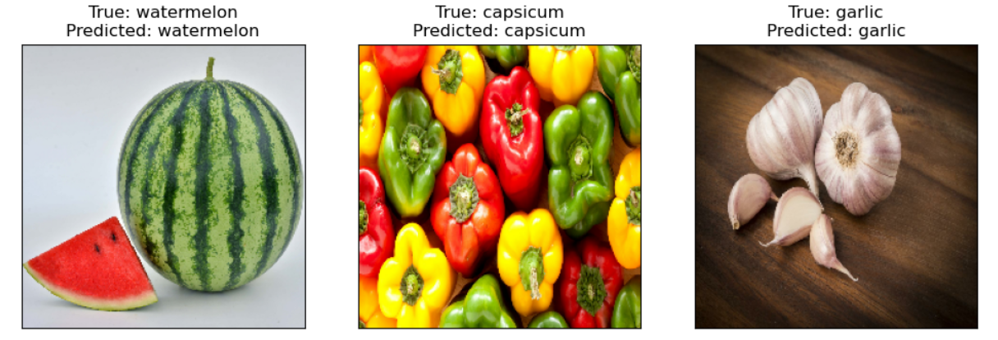
RESULTS

